Slide 1


Slide 2
DATA COLLECTION:
180 Fields for every player in FIFA 18.
Player info
DOB, club, league, nationality, salary and physical attributes
All playing attributes
Finishing, dribbling, potential, pace, shoot, pass
Special attributes
skill moves and international reputation
Traits and specialties
stamina, strength, sliding tackle, standing tackle
Overall, potential, and ratings for each position.

Slide 3
REGRESSION
PHYSICALITY
DEFENSE

Slide 4

PHYSICALITY

Slide 5
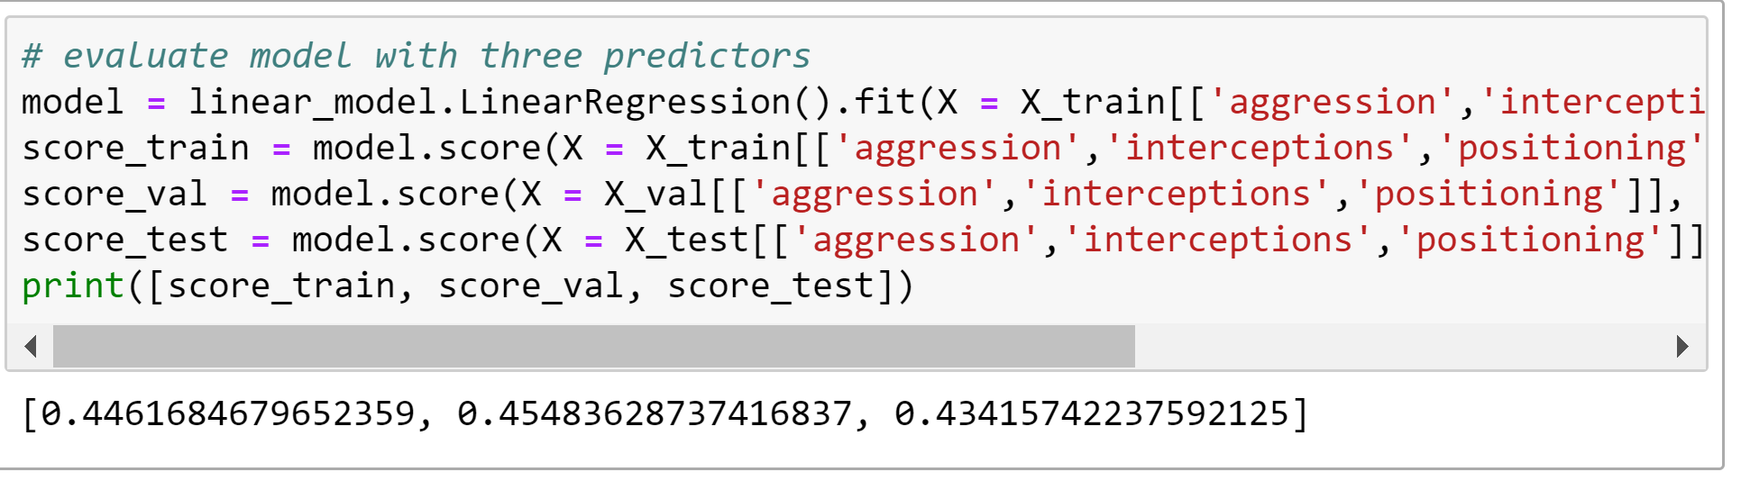
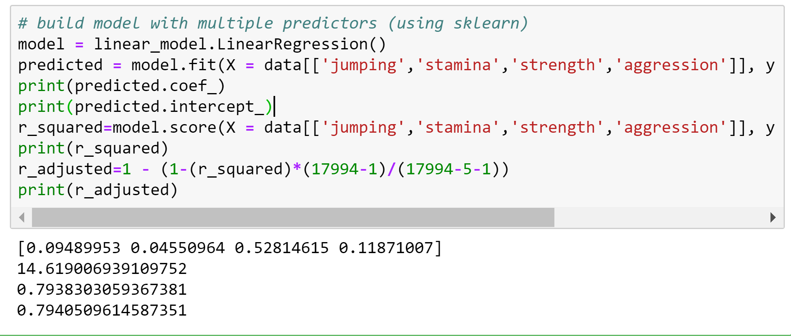
ATTRIBUTES
aggression, interceptions and positioning – < 50%
After selecting the attributes based on correlation coefficient:
jumping, stamina, strength, aggression, agility – 80%

Slide 6
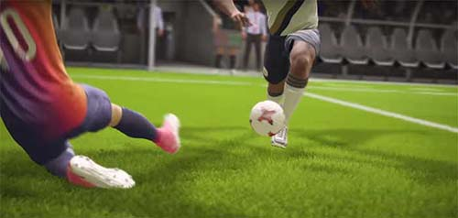
DEFENSE

Slide 7
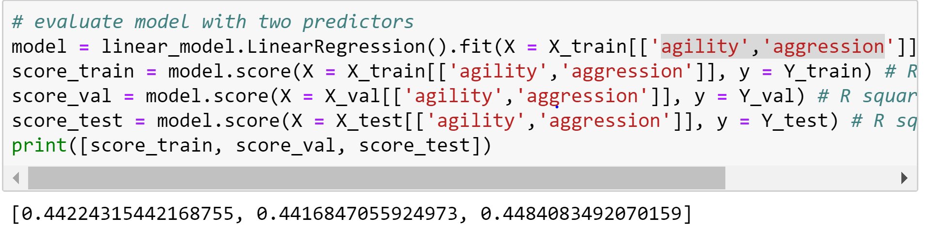
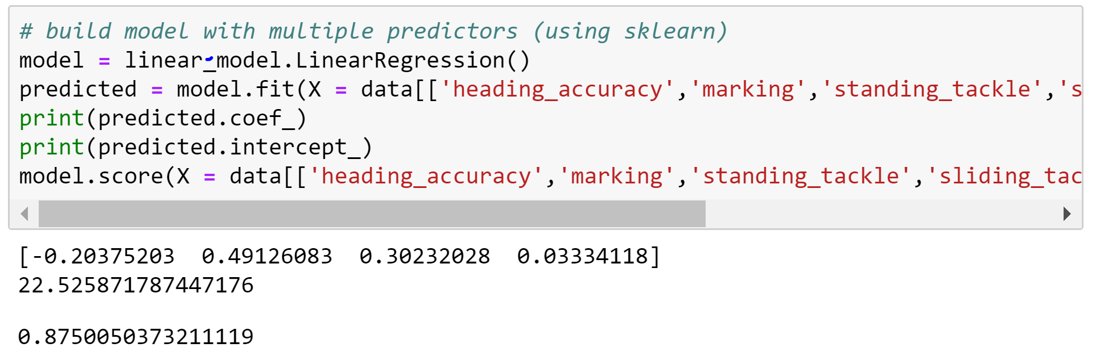
ATTRIBUTES
agility, aggression – <50%
After selecting the attributes based on correlation coefficient
aggression, standing tackle, sliding tackle, marking, heading accu— 85%

Slide 8
CLASSIFICATION
Work rate attack
Work rate defence

Slide 9
Work rate attack
pace
Shoot
pass
Dribling
Physicality
Agility
Reactions
Balance
Shot power
Jumping
Jumping
Stamina
Strength
Aggression
Positioning
Left wing
Right wing

Slide 10
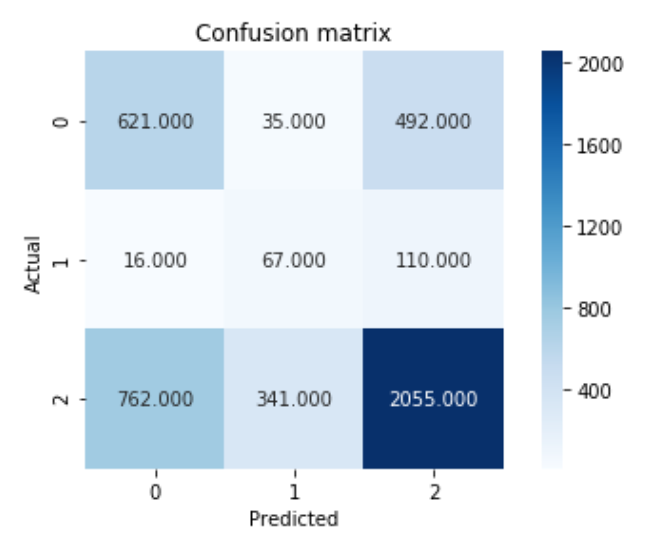
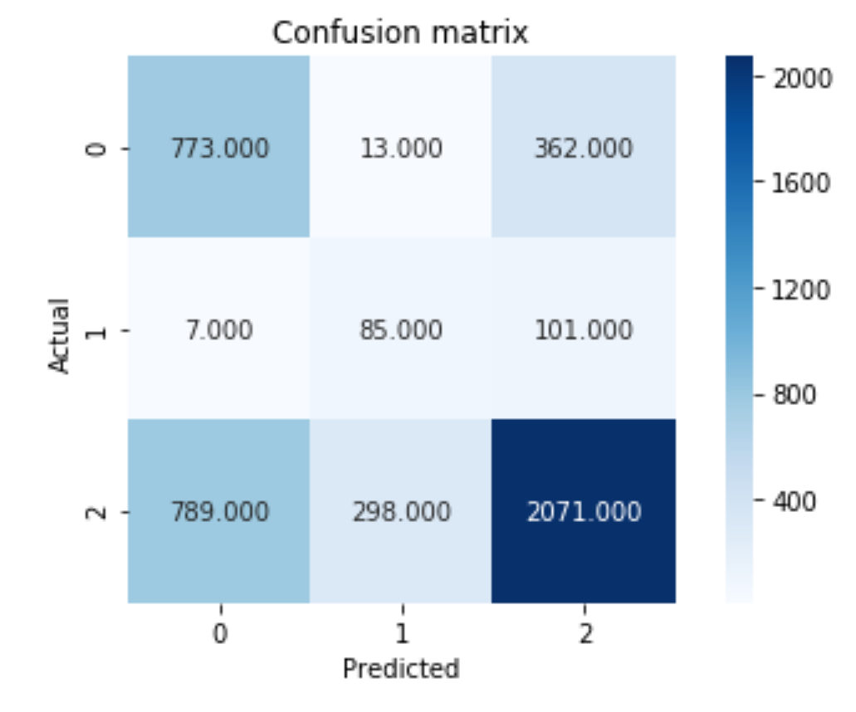
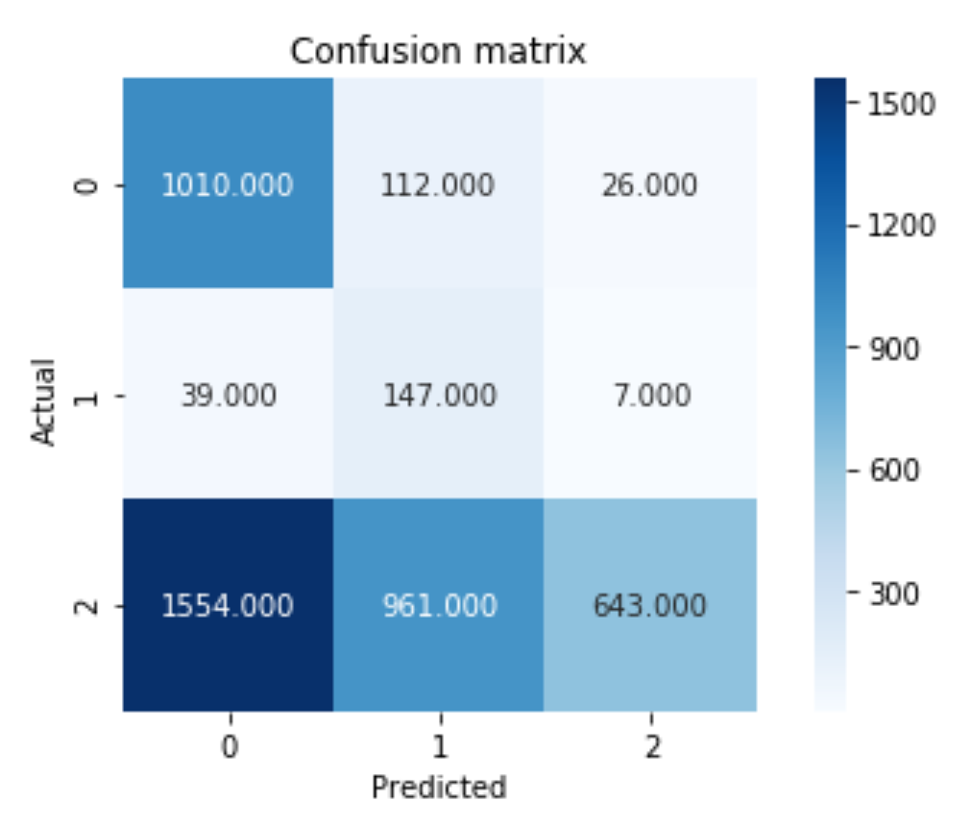
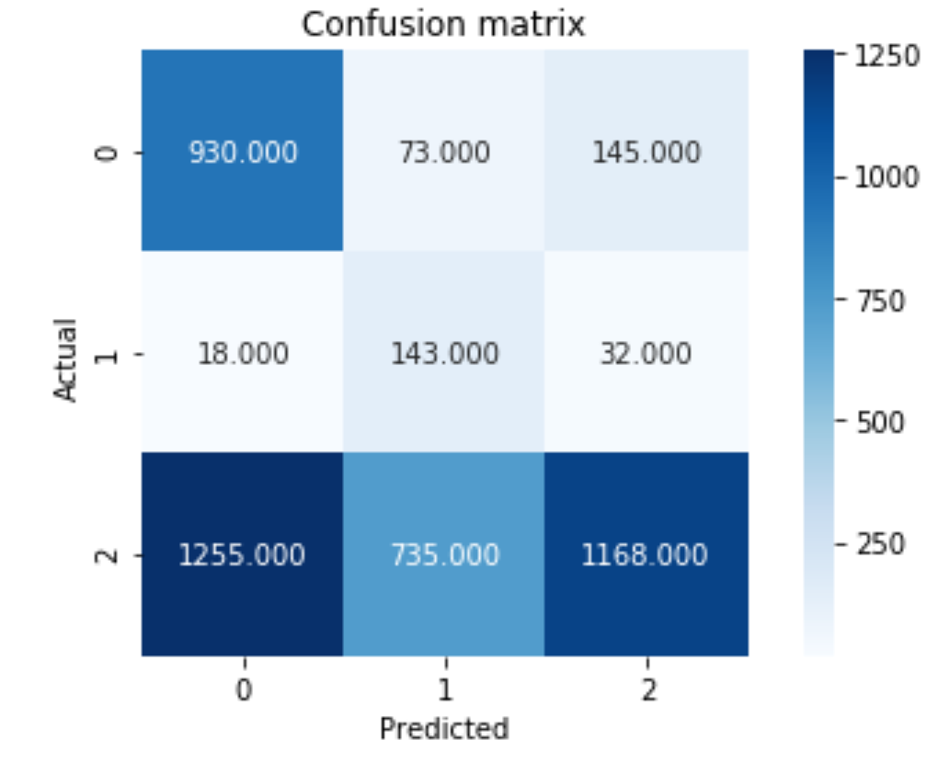
Decision Tree Random Forest KNN Naïvebayes
Accuracy : 0.609
Error: 0.39
Precision :
[0.44388849 0.151241 0.7734]
Recall :
[0.54094 0.34715 0.072]
F1 score :
[0.4763 0.21069 0.7067]
Accuracy :0.65103356
Error: 0.3489
Precision:
[0.4926 0.2146 0.817]
Recall:
[0.673340.44041 0.65579
F1 score:
[0.56900 0.288 0.727]
Accuracy: 0.498
Error: 0.501
Precision:
[0.422 0.150 0.868]
Recall:
[0.810 0.740 0.369]
F1 score:
[0.555 0.250 0.51]
Accuracy: 0.400
Error: 0.599
Prcision:
[0.388 0.120 0.951]
Recall:
[0.879 0.761 0.203]
F1 score:
[0.538 0.208 0.335]

Slide 11
Work rate Defence
pace
pass
shoot
reactions
Physicality
Standing tackle
Sliding tackle
Heading accuracy
Shot power
Finishing
Jumping

Slide 12
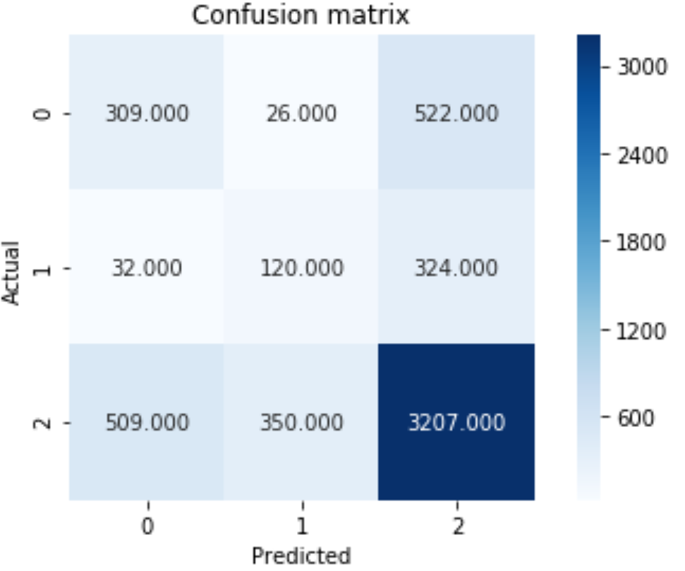
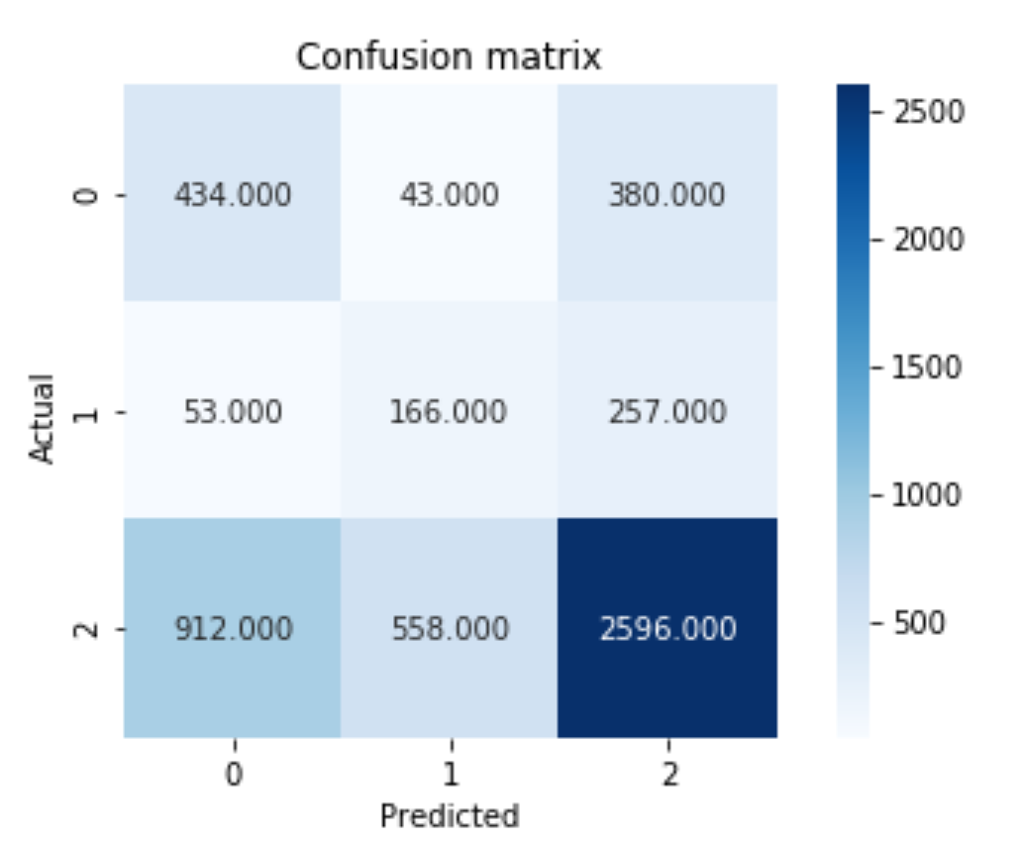
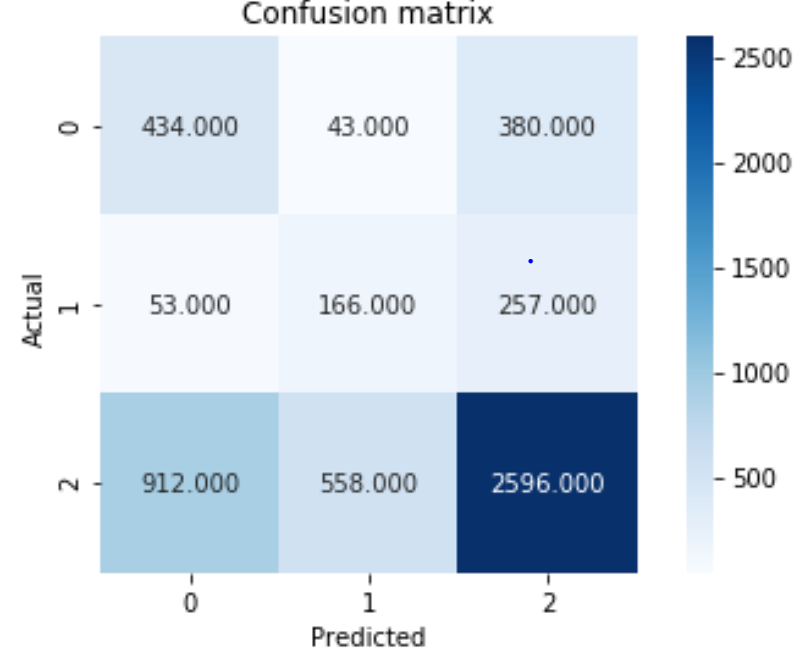
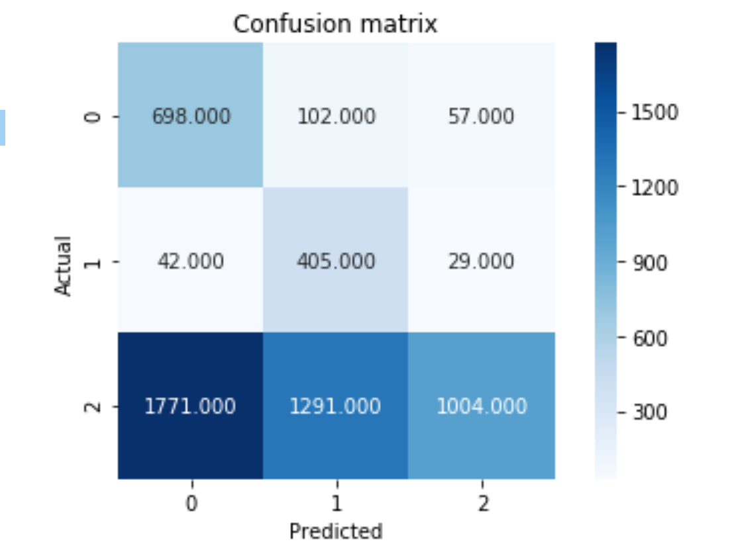
Decision Tree Random Forest KNN Naïve bayes
Accuracy:0.673
Error:0.326
Precision:
[0.363 0.241 0.791]
Recall:
[0.360 0.252 0.788]
F1 score:
[0.362 0.246 0.789]
Accuracy: 0.591
Error: 0.408
Precision:
[0.310 0.216 0.802]
Recall:
[0.506 0.348 0.638]
F1 score:
[0.384 0.267 0.711]
Accuracy: 0.691
Error:0.308
Precision:
[0.405 0.262 0.794]
Recall:
[0.374 0.256 0.809]
F1 score:
[0.389 0.259 0.801]
Accuracy: 0.390
Error: 0.609
Precision:
[0.277 0.225 0.921]
Recall:
[0.814 0.850 0.246]
F1 score:
[0.414 0.356 0.389]

